Slide 1
Customer Journey
-
Bahamas

Slide 2


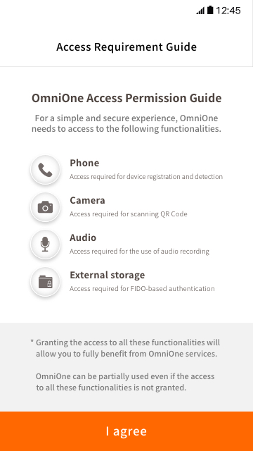
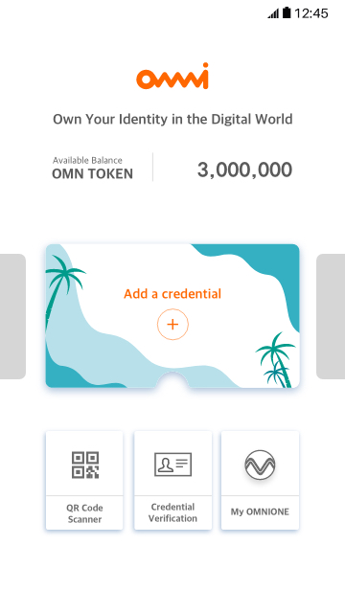
Introduction – Screen to be seen at your first login
Description
1 | Intro
2 | Access Requirement Guide
3 | OmniOne main menu
1
2
3

Slide 3
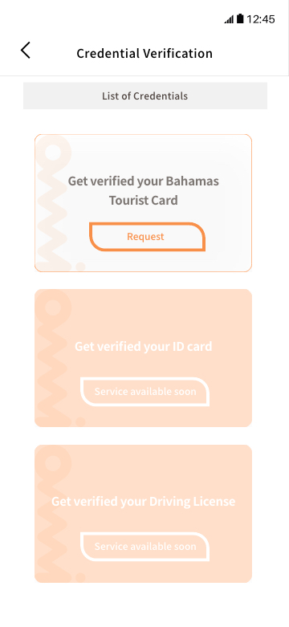
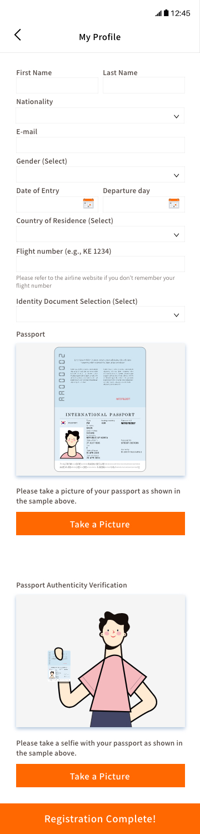
Add a credential – Input data (1/2)
Step 1: Click on “Add a credential”
Step 2: Click on “Request”
Step 3-1: Fill in your profile data
Step 3-2: Take a picture of your passport
Step 3-3: Take a selfie with your passport

Slide 4
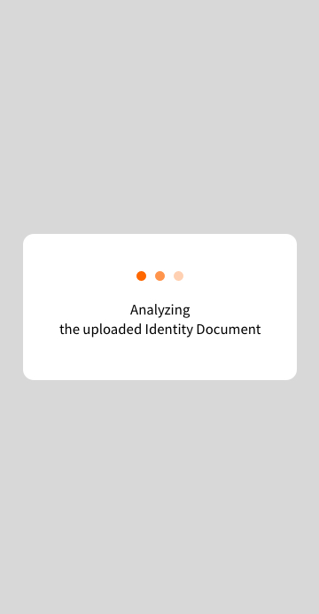

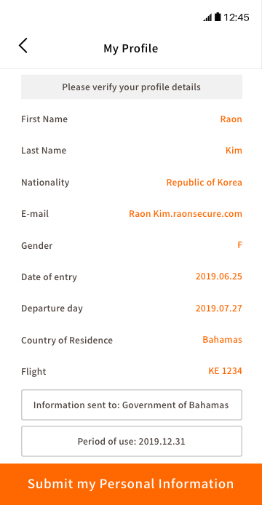
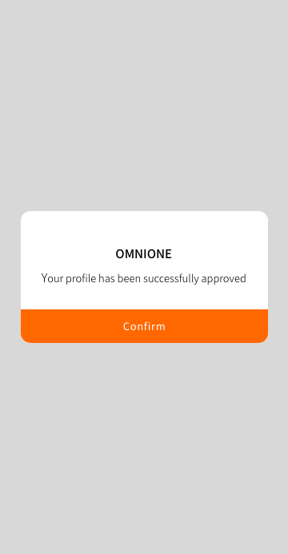
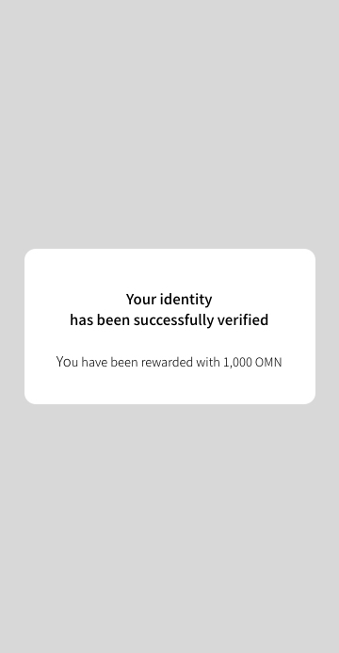
Add a credential – Verification process (2/2)
Step 4-1: Analyzing data
Step 4-2: Verifying format
Step 5: Once you checked your profile, you can submit your data
Step 6: Pop-up announcing the completion of the process
Step 7: Pop-up announcing the receipt of the reward

Slide 5
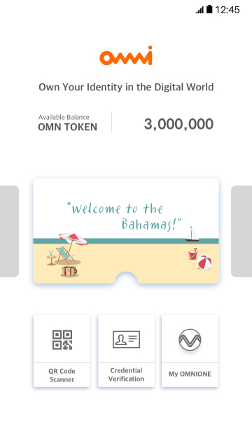
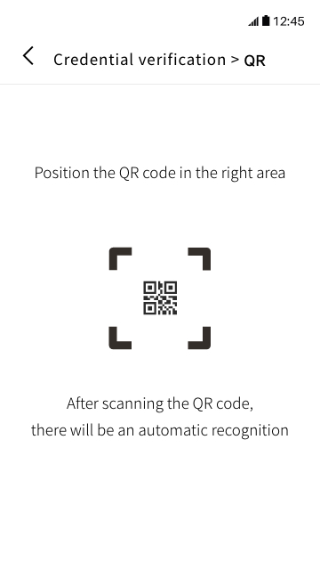
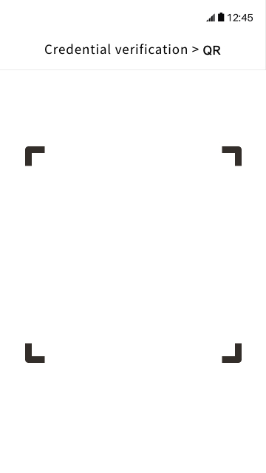
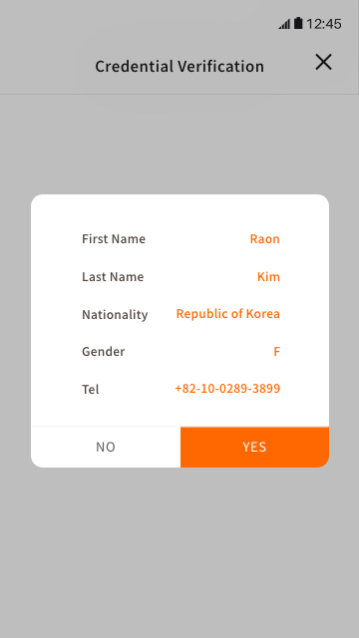
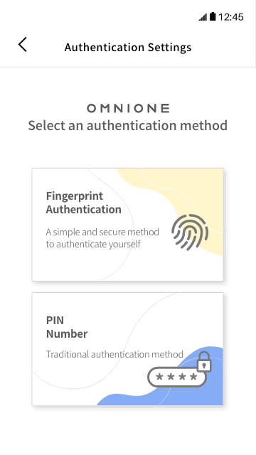
QR Code Scanner
Step 1: Click on “QR Code Scanner”
Step 2: Follow the instruction
Step 3: Scan the QR code
Step 4: Verify your personal information and click on “Yes” if correct, otherwise click on “No”
Step 5: Select the authentication method and perform to the authentication. After performing authentication, you will be redirected to step 1

Slide 6
Credential Verification
< My Credential
Exit to Menu
Step 1: Click on QR Code Scanner
Step 2: Verify your credential

Slide 7
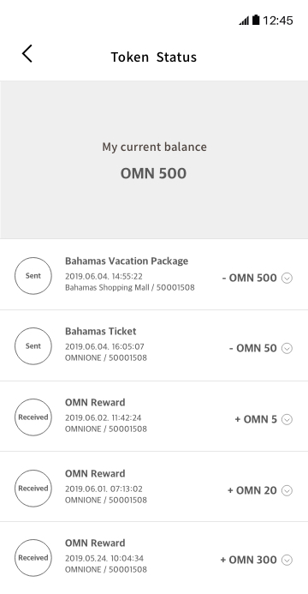
My OmniOne
Step 1: Click on QR Code Scanner
Step 2: Verify your transaction history

